Slide 1
Industrialized Additive Manufacturing
Ruel A. (Tony) Overfelt, Ph.D.
Professor of Materials Engineering
(334) 844-5940
overfra@auburn.edu

Slide 2

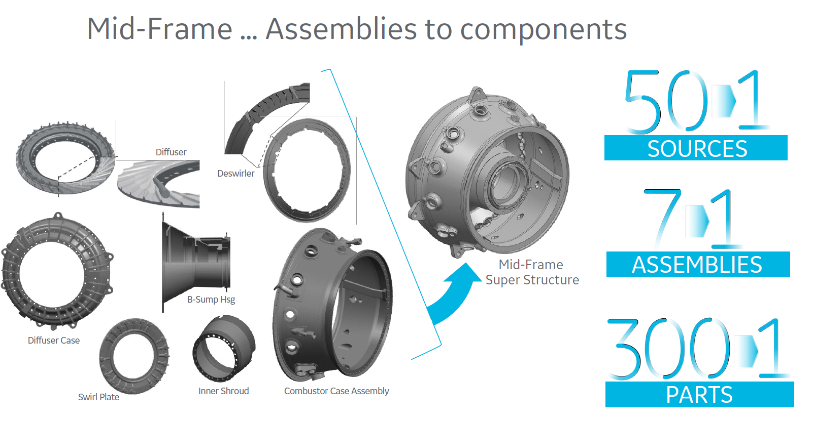
GE is Planning to
Reset Supply Chain Costs
Disintermediation . . .
geadditive.com

Slide 3
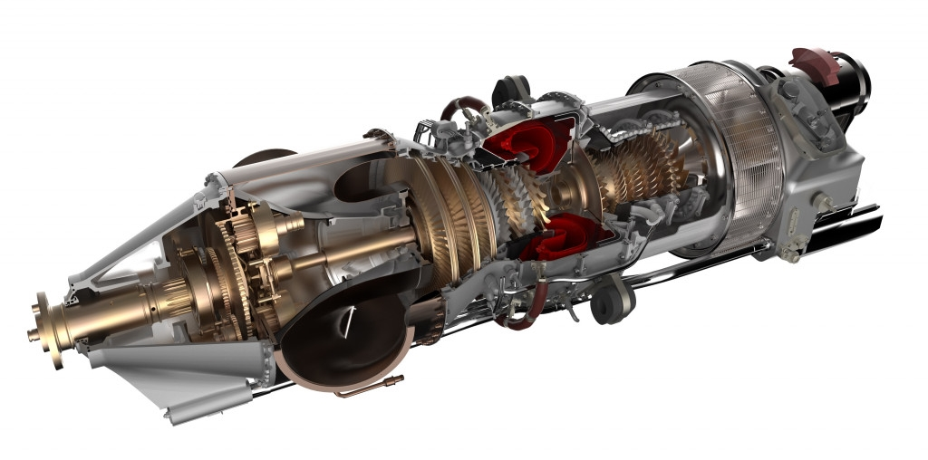
Another Example from GE
Advanced Turboprop Engine
35% of the engine
5% lighter
1% more efficient
Time-on-wing ↑33%
20% Cost Savings
GE is using additive manufacturing to consolidate 845 parts into 12!
geadditive.com
Notes:
845 parts into just 11

Slide 4
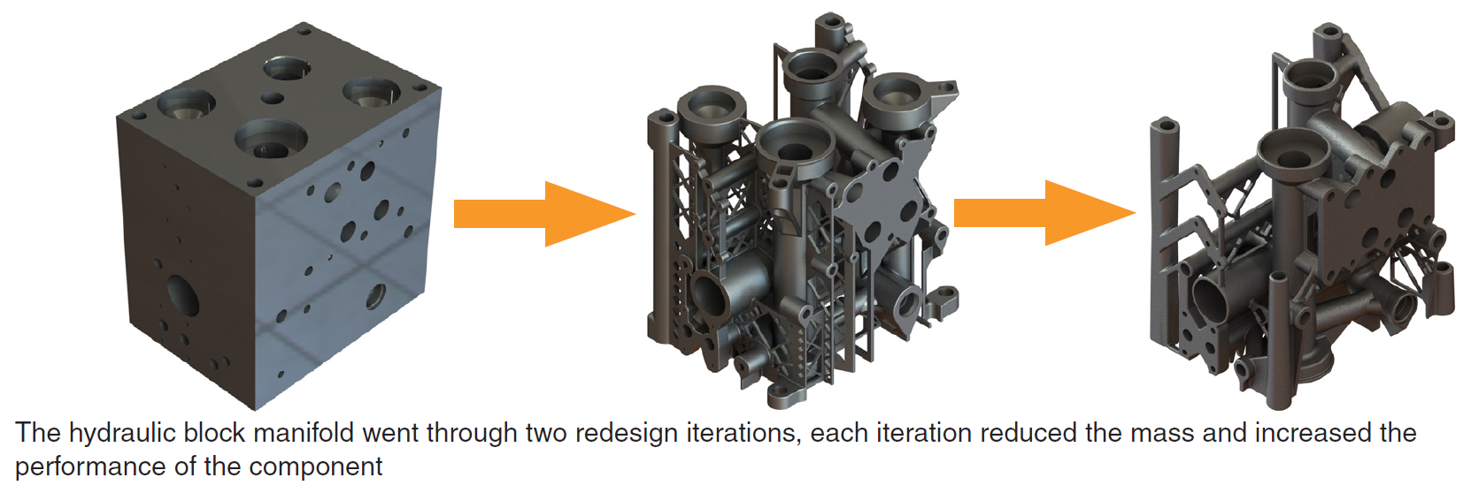
Additional Applications for Additive Manufacturing
Hydraulic Power Systems
Power steering systems
Power brake systems
Aircraft control actuators
Tractor, bulldozer, etc. power systems
Servohydraulic test systems
Factory automation and robotics
Machine tool workholding systems
renishaw.com

Slide 5
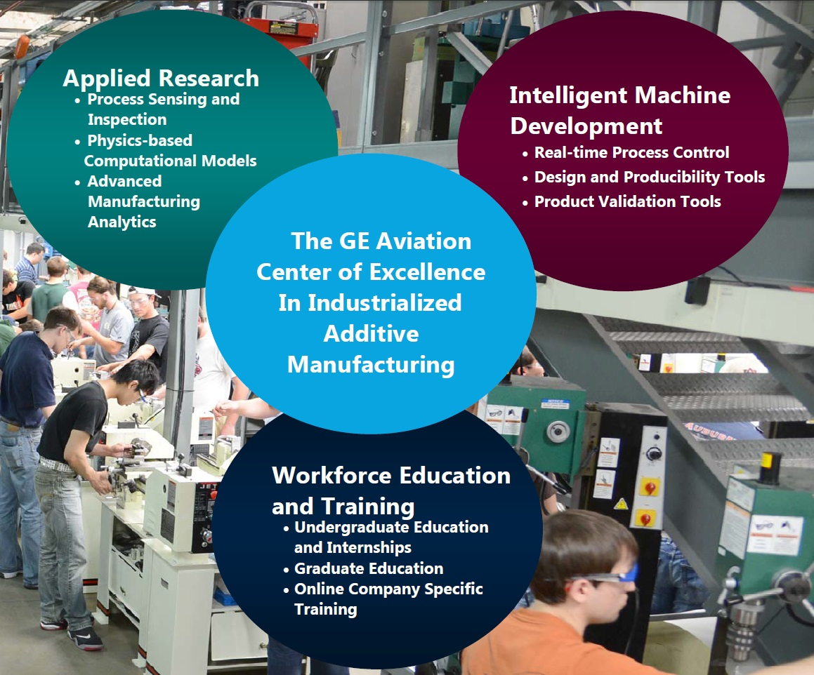
Applied Research
Microstructure and Properties
Process Sensing
Physics-based Models
Intelligent Hybrid Machines
Integrated Manufacturing Systems
Real-time Process Control
Process/Product Validation
Center
for
Industrialized
Additive
Manufacturing
Workforce Education & Training
UG Education & Internships
Graduate Education
Company Specific Training
5

Slide 6
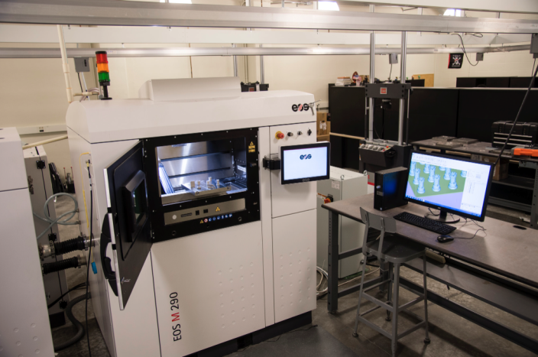
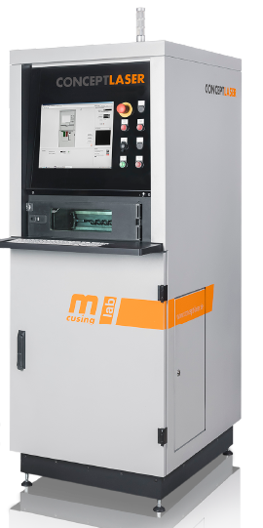
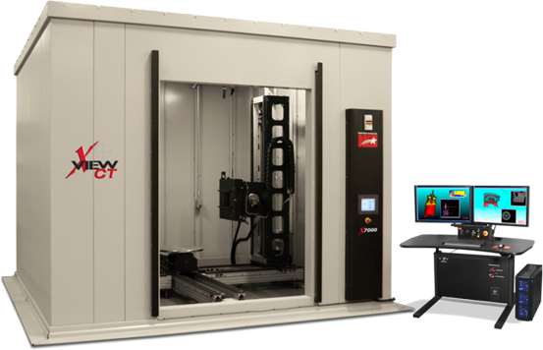
Additive Manufacturing
Equipment Investments
Teaching equipment: ~$500k
Multiple polymer-based 3D printers purchased for student use in Aerospace, Biosystems, Industrial & Systems, Materials, and Mechanical Engineering
Research equipment: ~$2.5M
Advanced polymer-based printers
Concept Laser Mlab Cusing 100R
EOS M290 metal printer
Renishaw AM 250
CNC-based metal deposition
Powder characterization
Fatigue testing laboratory
500kV X-ray Computed Tomography
Inside a shielded 9’ X 9’ X 9’ vault.
6
Notes:
225kV microfocus tube ($120K)

Slide 7
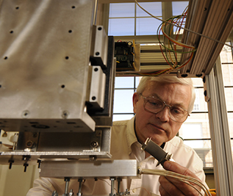
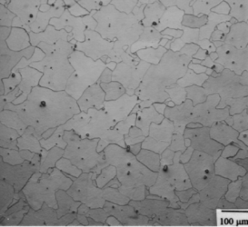
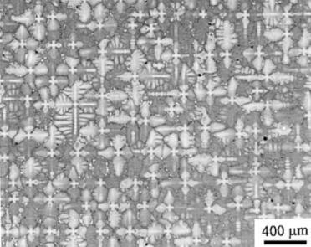
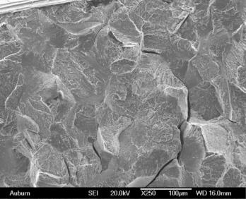
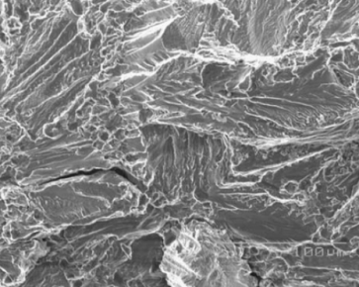
Dr. Tony Overfelt
Center for Industrialized Additive Manufacturing
High temperature superalloys:
IN713, IN718, Mar-M-247
Rene’ N5, Rene’ 88, Rene’ 108, PWA 1484
Cobalt-based FSX-414
Low density aerospace structural alloys:
Ti-6Al-4V
Al-Be AlBeMet^{tm} alloys
Magnesium alloys: WE43, AE42, AM60
Aluminum alloys: A201, A319, A356
Ferrous alloys:
4340, ductile iron, Class 40 gray iron,
CG iron, CF8M stainless steel
Copper alloys:
Cu-P, Cu-Sn-Zn-Bi
Processes:
Investment casting
Sand casting
Die casting
Directional solidification
Particulate molding
Investigations into:
Castability and defects
Solidification microstructures
Thermophysical properties
Tensile properties
Fracture and fatigue
Projects funded by:
NIST, NASA, FAA, DARPA, ARO, DOE, Industry

Slide 8
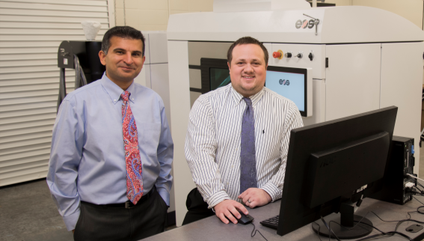
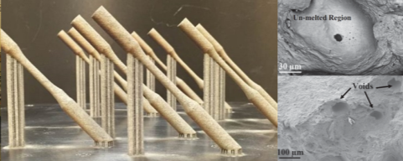
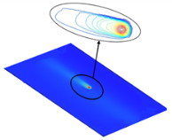
Dr. Nima Shamsaei
Additive manufacturing, fatigue, failure analysis, fracture mechanics, mechanical behavior of materials
Dr. Scott Thompson
Additive manufacturing, thermal/fluid modeling, thermomechanical simulation, thermal management, thermal properties
Mechanical testing of additive manufactured parts:
Multiple MTS uniaxial fatigue machines
MTS multiaxial fatigue machine
Uniaxial and multiaxial extensometers
Freeman FT4 metals powder characterization system
Creep and hardness testing capabilities
Mechanical testing at elevated temperature (up to 1000 ºC)
Validated thermomechanical simulation:
Residual stress, cooling rate predictions
Reduce trial/error associated with parameter learning
Additive manufacturing on site:
EOS M290 DMLS system
Renishaw AM250 system
Materials:
Ti-6Al-4V, Inconel 718,
stainless steels (17-4, 316L), cobalt-chromium, aluminum alloys
Projects funded by:
NSF, ONR, NavAir, NASA

Slide 9
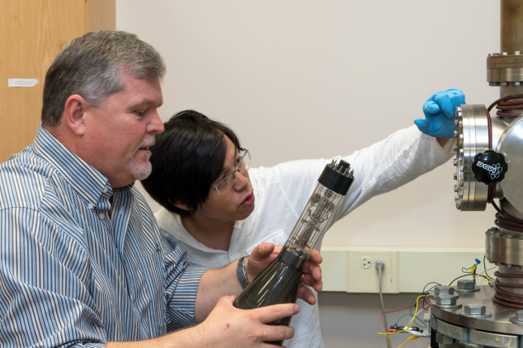
Dr. Bart Prorok
Professor of Materials Engineering
Characterization:
SEM, TEM
EDS, WDS, EBSD
X-Ray Diffraction
Scanning Probe Techniques
Microstructure/Texture
Interferometry
FTIR, Raman, others
Micro/nanoscale testing:
Failure Analysis
Microstructure/Property Relationships
Hierarchical Structural Materials
Multi-Layer Composites
Bio-minerialized Materials
Sensors – Physical and Chemical
Additive manufacturing:
Construction of Custom E-beam Machines
X-ray Computed Tomography
E-Beam/matter interactions:
Dose Calculations and Control
Proximity Effect and Corrections
X-Ray Characterization

Slide 10
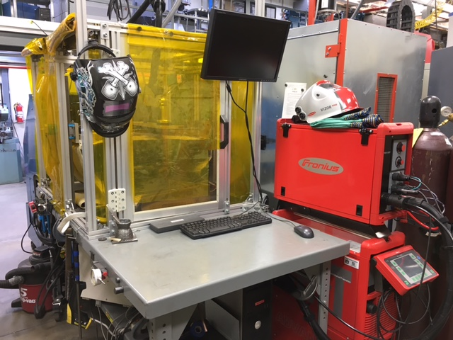
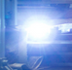
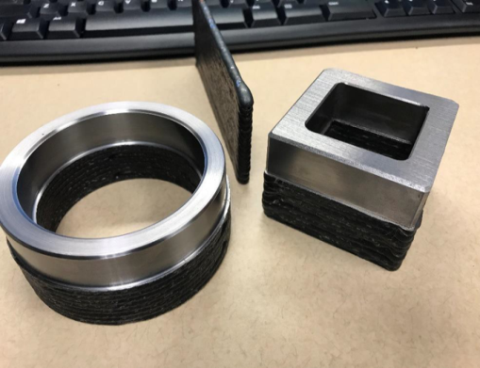
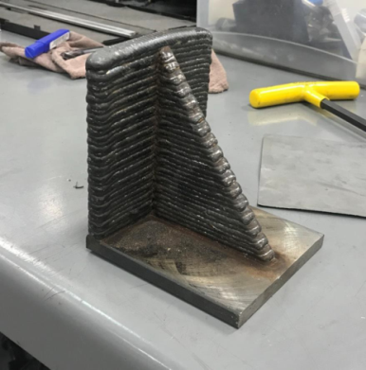
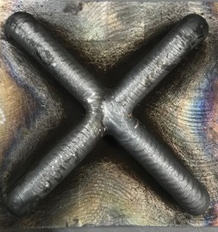
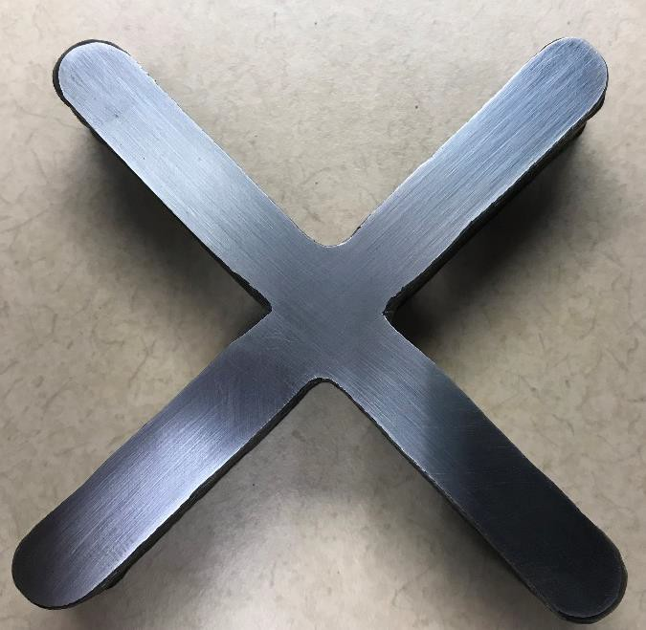
Wire Arc Additive Manufacturing
Product/Process Development
Current Capabilities
18 x 18 x 18 in. build volume
3-axis CNC machine
Precision ball screws & linear rails
Electrically/thermally insulated build plate
Voltage/current monitor
FLIR A6751sc infrared camera
Miller 190 welding power supply
Fronius 4000 CMT power supply
Future Capabilities:
Pro-Fusion Dual Arc 82 Micro-Plasma Power Supply
4 & 5 axis CNC capability
Integrated machining spindle

Slide 11
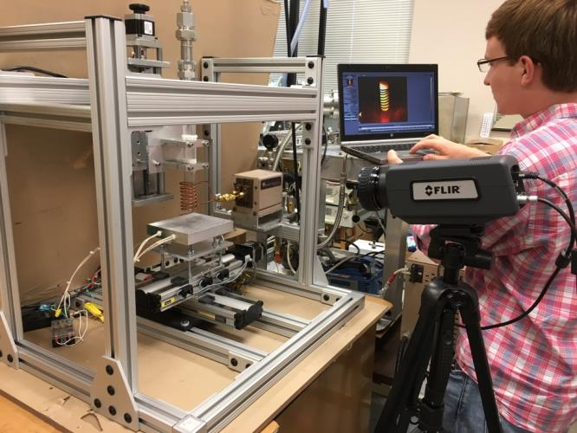
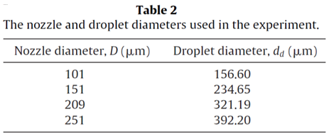
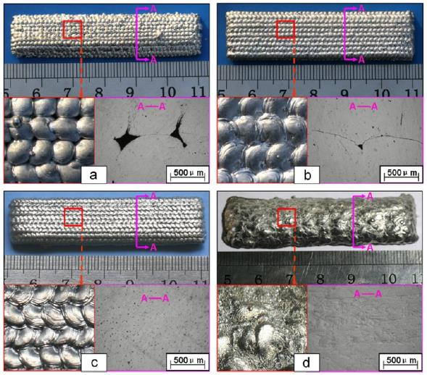
Precision Droplet Deposition
Pb-Sn
Chao et al, J Mat Proc Tech, 212 (2012) 484-491.
7075 Al
T_{d}=660ºC, T_{b}=350ºC
T_{d}=680ºC, T_{b}=400ºC
Current Capabilities
6 in x 6 in x 6 in build volume
3-axis CNC machine
Precision ball screws & linear rails
1000W induction melting power supply
(5kW and 100 kW available)
Thermally controlled build plate
FLIR A6751sc infrared camera
Protective atmosphere environment
T_{d}=700ºC, T_{b}=450ºC
T_{d}=740ºC, T_{b}=500ºC
Chao et al, Int J Machine Tools Manufacture, 69 (2013) 38-47.

Slide 12
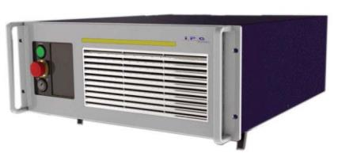
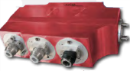
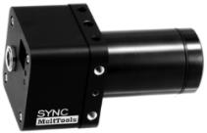
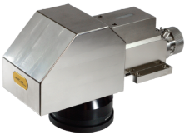
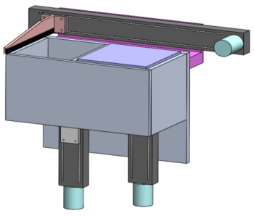
-- Coming --
Additive Manufacturing Test Bed
IPG Photonics
2-way fiber switch
IPG Photonics
YLR-300/3000-QCW-MM
1070 nm fiber laser
300 W CW
3000 W Pulsed
0-50 kHz modulation
10μsec width
IPG Midpower Scanner
Observation window: 450-900 nm
150 μm spot size
Higher melting efficiencies
Optimization of roughness at edges via pulse shaping
Laser ultrasonic detection of flaws
450-900 nm
MeltView SYNC Camera
1200 fps @ 640pix X 240pix
High dynamic range
GigE output
AU Designed
Powder Bed System
150 X 150 X 100 mm
20 micron layers
1 micron repeatability

Slide 13

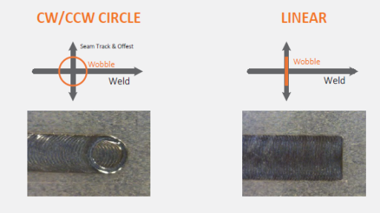
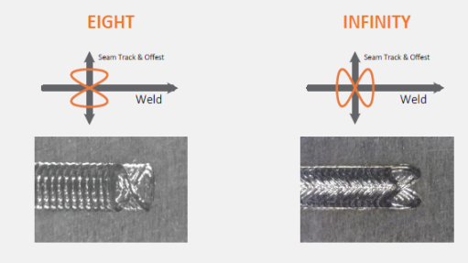
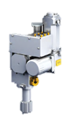
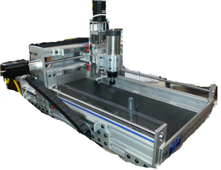
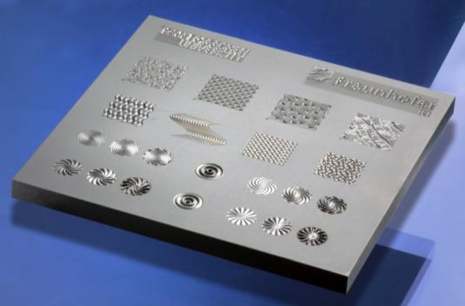
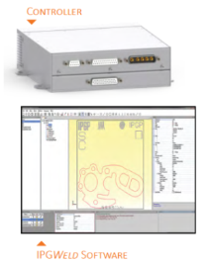
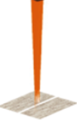
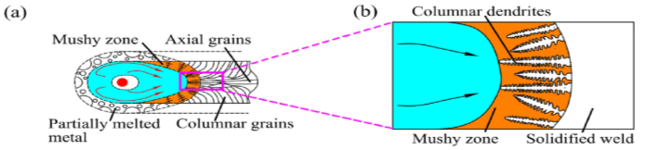
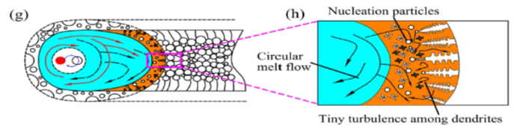
-- Coming Soon --
Additive Manufacturing Test Bed
IPG Photonics
YLR-300/3000-QCW-MM
1070 nm fiber laser
300 W CW
3000 W Pulsed
0-50 kHz modulation
10μsec width
IPG Photonics
2-way fiber switch
IPG Photonics
FLW-D30-W Wobble Head
100 μm spot size, 3 m/s max speed
Small field scanning (15 X 15 mm) Software for custom shapes
Real-time process monitoring
Minimize maximum temperatures
Maximize melting efficiency
Minimize vaporization
PDJ Pilot Pro CNC
Precision ball screws
26” X 26” X 5” build
Wire or powder feed
Large powder bed
Perform hot wire laser deposition
Laser drilling, cutting, surface polishing and texturing
Temmler et al, J. Laser Appl., 29(2017)
Wang et al, Materials and Design., 108(2016) 707-717.

Slide 14
Discussion

Slide 15
